Slide 1
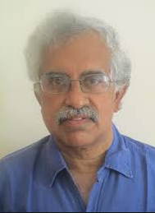

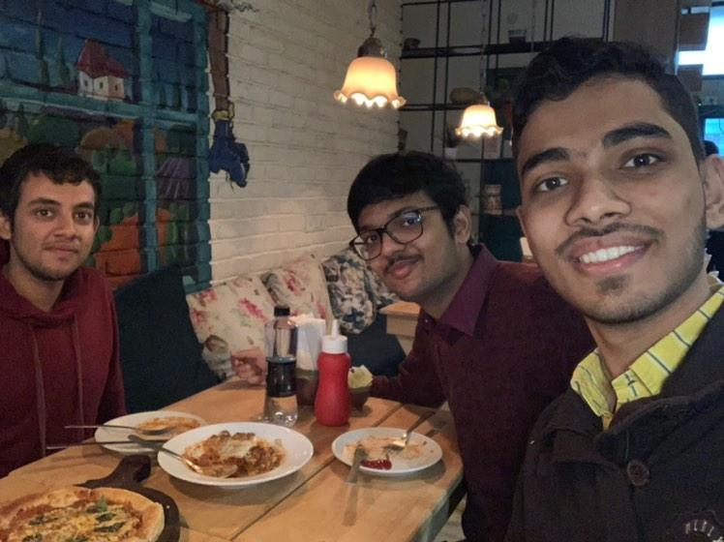
Design Innovation Summer Award (DISA) 2019
Problem Statement:
Wearable Glove to Reduce Tremors
Faculty Mentor: Prof. M. Balakrishnan
Team:
Rachit Jain 2018ME10032
Chirag Bansal 2018CS50402
Ishan Jain 2018EE10545

Slide 2
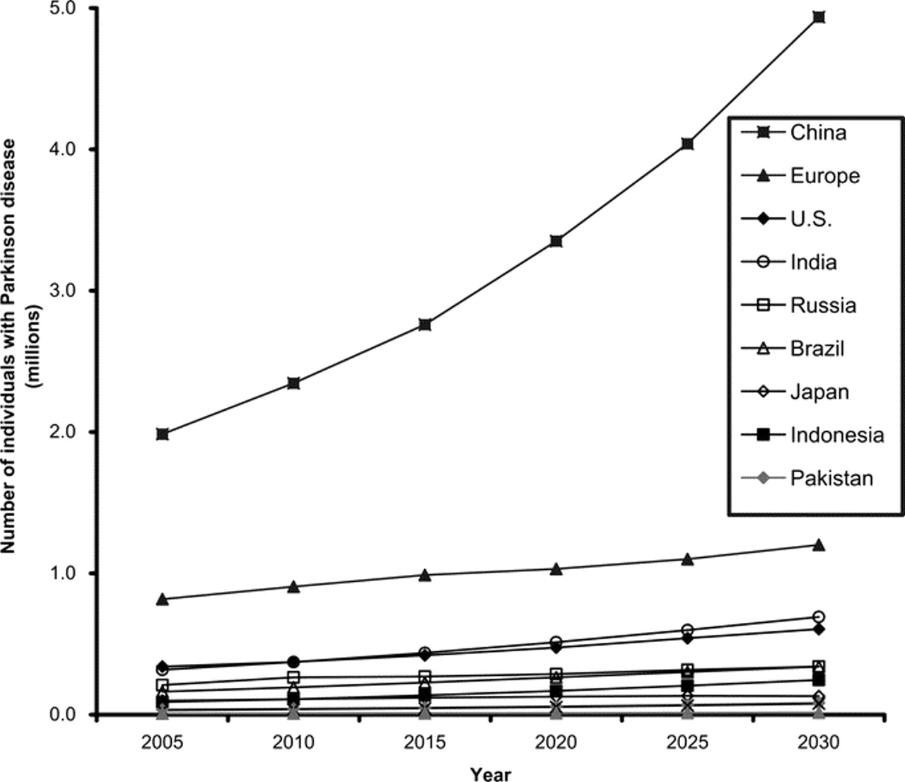
“Wearable Glove to reduce tremors”
THE PROBLEM
WE ADDRESS
Essential Tremors and tremors in diseases like Parkinson’s Disease, Multiple Sclerosis, Huntington’s Disease, etc. significantly impact the quality of life
These uncontrollable tremors make it almost impossible for the patients to do day-to-day activities from brushing, eating, drinking to wearing clothes
The very grip of the hand is hugely affected. While drug therapy provides transient relief, the expense and potent side effects can be an obstacle
Not only the patient, but his family members feel frustrated and embarrassed of his inability to have a control of his body
It was shocking to know that out of 6-8 professors we approached for this project, 2 of them had their very close ones affected by this life disabling disease
Growth of population affected by Parkinson’s Disease
DISA 2019 | Prof. M. Balakrishnan | Rachit Jain, Chirag Bansal, Ishan Jain

Slide 3
Tremor Causing Diseases
Parkinson’s disease is a neurodegenerative condition – an illness that affects nerve cells in the brain that control movement.
Multiple sclerosis is a chronic illness involving your central nervous system. The immune system attacks myelin, the protective layer around nerve fibres.
Huntington’s disease is a hereditary condition in which your brain’s nerve cells gradually break down. This affects your physical movements, emotions and cognitive abilities.
Tremor is the most common movement disorder. Its incidence and prevalence increase with ageing, affecting more than 4% of the patients older than 65 years . More than two-thirds of the population with upper limb tremor face serious difficulties in daily life.
DISA 2019 | Prof. M. Balakrishnan | Rachit Jain, Chirag Bansal, Ishan Jain

Slide 4
More on Parkinson Disease
A patient with a Parkinson’s tremor will typically find that their symptoms worsen and spread to other parts of the body over time. Generally, the tremor starts in one hand and can progress (normally over the course of many years) to the arm and foot on the same side of the body, and then eventually to the other side of the body. In severe cases, tremors also can affect the jaw or lips.
Physical therapy can help some patients control their tremors better, as can reducing the intake of substances such as caffeine, which can induce tremors. Many patients experience an increase in the severity of their tremors when they are stressed. Therefore, trying to reduce sources of anxiety and engaging in complementary therapies (such as yoga or aromatherapy) may help some patients.
DISA 2019 | Prof. M. Balakrishnan | Rachit Jain, Chirag Bansal, Ishan Jain

Slide 5
Tremors
A tremor can be defined as a rhythmic shaking of a body part. It occurs in healthy individuals as the so-called physiological tremor, which is composed of two distinct oscillations superimposed on a background of irregular fluctuations in muscle forces and displacements .
Tremors consist of involuntary movements in the human body. It is approximately periodic and roughly sinusoidal in nature. Frequency of tremor can be classified into 3 categories: slow (3-5 Hz), intermediate (5-8 Hz) and rapid (9-12 Hz).
The cause of tremor is either physiological or pathological. Physiological tremor is intrinsic with all humans. Pathological tremor is either idiopathic or occurs secondary to a disorder such as a brain tumor, alcohol or drug withdrawal, multiple sclerosis, etc. Essential and Parkinsonian tremor are two common types of pathological tremors
DISA 2019 | Prof. M. Balakrishnan | Rachit Jain, Chirag Bansal, Ishan Jain

Slide 6
Classification of Tremors
Tremor is primarily classified on the basis of when it occurs, either with a certain posture, at rest or during action. There are 3 broad classifications:
Postural tremor: When the patient tries to maintain a posture against gravity, such as holding the arms out in front of the body. A postural tremor occurs with 5 to 9 Hz frequency.
Action tremor: An action tremor (kinetic or intention tremor) occurs during movement of the affected body part from one point to another. A task-specific tremor occurs only when the patient begins to perform a highly skilled activity, such as writing or speaking.An action tremor occurs with 3 to 10 Hz frequency.
Rest Tremor:A resting tremor occurs when the patient is attempting to maintain the position of a body part at rest. A postural tremor occurs with 3 to 6 Hz frequency.
DISA 2019 | Prof. M. Balakrishnan | Rachit Jain, Chirag Bansal, Ishan Jain

Slide 7
Coping with Tremors
For coping up with tremors these are the methods people use:
Medication : Basic medications to help manage the symptoms, inhibitors to help your medication last longer, something else to help with side effects. Treating tremors with medicines is a risky , there are no drugs which will cure the disease for sure and there are always side effects. Most of the time it becomes more of a harm than help.
Surgery : There are many surgeries one can do to reduce the symptoms of tremors, but they are costly, have high risk and don’t work 100% of the time.
Therapy : They are used to reduce the intensity of tremors.
Physical Aid to help patients with tremors physically
Thus there is a dire need to have a solution to the problem of tremors which is economical, easily available, has no impacts on the brain or nervous system and does not interfere with the body in any manner. Also, the glove will help those patients highly who have not been cured completely.
DISA 2019 | Prof. M. Balakrishnan | Rachit Jain, Chirag Bansal, Ishan Jain

Slide 8
Voluntary or Involuntary?
Vibration Analysis
Categorisation of tremors based on voluntary and involuntary movement
DISA 2019 | Prof. M. Balakrishnan | Rachit Jain, Chirag Bansal, Ishan Jain

Slide 9
Electromechanical Devices
To make sense out of ns anad to quantify them on a computer, certain electromechanical components were extremely essential.
Gyroscopes
Hand tilt
Moving hand to be analysed
Bluetooth Module Send Data
Accelerometers Hand speed
DISA 2019 | Prof. M. Balakrishnan | Rachit Jain, Chirag Bansal, Ishan Jain

Slide 10
Next in line...
Further study of tremors and their behaviour, application of accelerometers, MEMs and Arduinos was the next step. After that we will develop a program that will identify whether the movement is voluntary or involuntary. We would try and apply the concept of gyroscope according to the behaviour of tremors. Using a tremor mimicking device and repeated trial and analysis, we would work out the correct positioning and optimum spin and other specifications of the gyroscope to make our results and progress better. We will then identify a portable power source that can power all the electrical components.
The research paper “Mechatronics device for tremor Sensing” with reference URL: https://ieeexplore.ieee.org/document/7012806, came in very handy during the next steps to be followed up.
DISA 2019 | Prof. M. Balakrishnan | Rachit Jain, Chirag Bansal, Ishan Jain

Slide 11
Vibration Analysis:
Vibration is most commonly measured using a ceramic piezoelectric sensor or accelerometer
Accelerometer is a sensor that measures the dynamic acceleration of a physical device as a
Pulse: Digital Accelerometer
Continuous Voltage: Analog Accelerometer
We would have to use a triaxial accelerometer, this accelerometer can create a 3D vector of acceleration in the form of orthogonal components
Involuntary movements such as tremors are nearly periodic and roughly sinusoidal in nature
Frequency of tremors can be classified into 3 categories:
Slow (3-5 Hz)
Intermediate (5-8 Hz)
Rapid (9-12 Hz)
As we want an accelerometer that is not that bulky and can be easily carried, we would need to use MEMS (Micro Electromechanical Systems) due to their small size, mass, volume with a very low power consumption and cost
DISA 2019 | Prof. M. Balakrishnan | Rachit Jain, Chirag Bansal, Ishan Jain

Slide 12
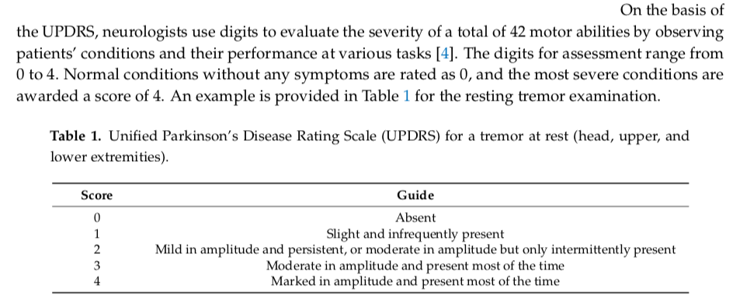
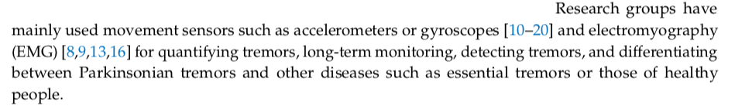
Accelerometers and Gyroscopes seemed the best way to go forward with the design of the prototype.
Their advantages and disadvantages, compared with the other equipments available in the market, were deeply discussed.
DISA 2019 | Prof. M. Balakrishnan | Rachit Jain, Chirag Bansal, Ishan Jain

Slide 13
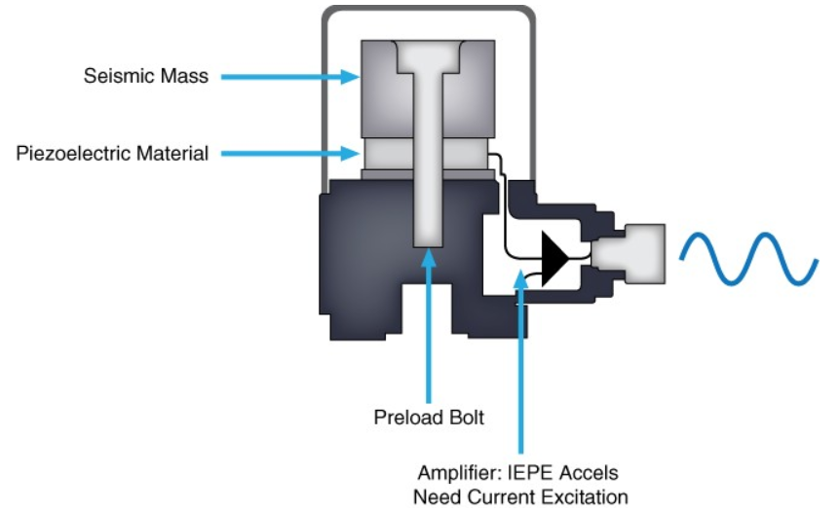
ACCELEROMETER
DISA 2019 | Prof. M. Balakrishnan | Rachit Jain, Chirag Bansal, Ishan Jain

Slide 14
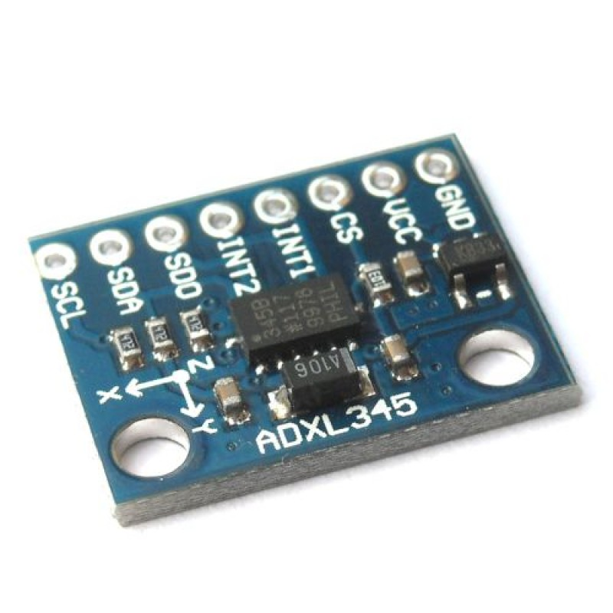
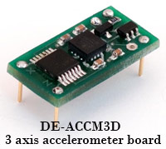
We feel initially it is better to use arduino as their advance functionality will help us a lot. If we are using an arduino, the triaxial accelerometer we would be using is ADXL 345 or ADXL335 (or a similar product).
Bandwidth - This refers to the amount of times per second you can take a reliable acceleration reading. For slow moving, tilt sensing applications, a bandwidth of 50Hz will probably suffice. If you intend to do vibration measurement, or control a fast moving machine, you will want a bandwidth of several hundred Hz.
DISA 2019 | Prof. M. Balakrishnan | Rachit Jain, Chirag Bansal, Ishan Jain

Slide 15
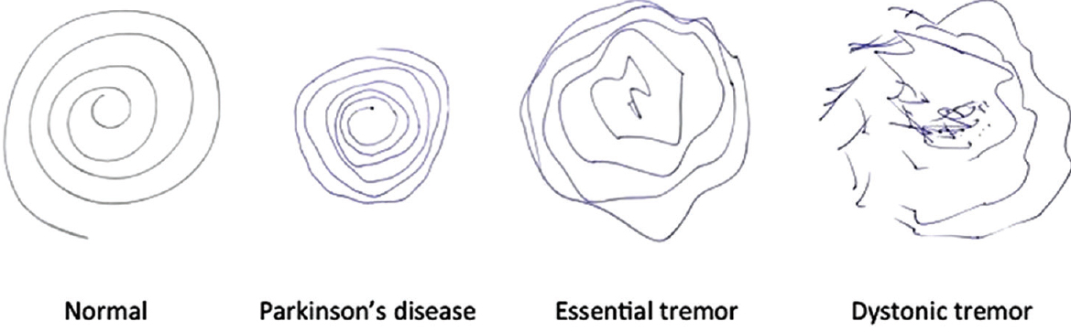
Detection of tremors
Would contact institutions/organisations mentioned ahead, where research and analysis on the data of actual Parkinson’s patients is done.
We can then, based on that, create a programme that would decide the spin axis and the spin speed for the gyroscopes
Spinning of the gyroscopes would be done accordingly
DISA 2019 | Prof. M. Balakrishnan | Rachit Jain, Chirag Bansal, Ishan Jain

Slide 16
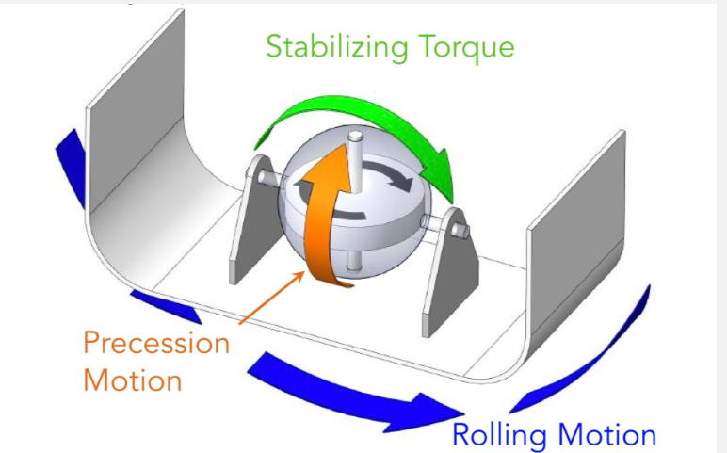
Gyroscopic Stabilizers
They are gyroscopes, which when rotated or moved, produce a restabilizing torque to oppose the movement.
DISA 2019 | Prof. M. Balakrishnan | Rachit Jain, Chirag Bansal, Ishan Jain

Slide 17
Functioning of Gyroscopes:
There are 3 axes in a gyroscope
It rotates about the “spin axis”, with the applied external force and the movement of gyroscope happening at the “input axis”
There is a precision axis, if we lock that axis, there will be no restoring torque provided by the gyroscope.
Rotating a high speed gyroscope is really difficult because it has a very high angular momentum and changing that momentum would take a lot of force
So based on whether it is voluntary movement or a tremor we would lock and unlock the axis.
DISA 2019 | Prof. M. Balakrishnan | Rachit Jain, Chirag Bansal, Ishan Jain

Slide 18
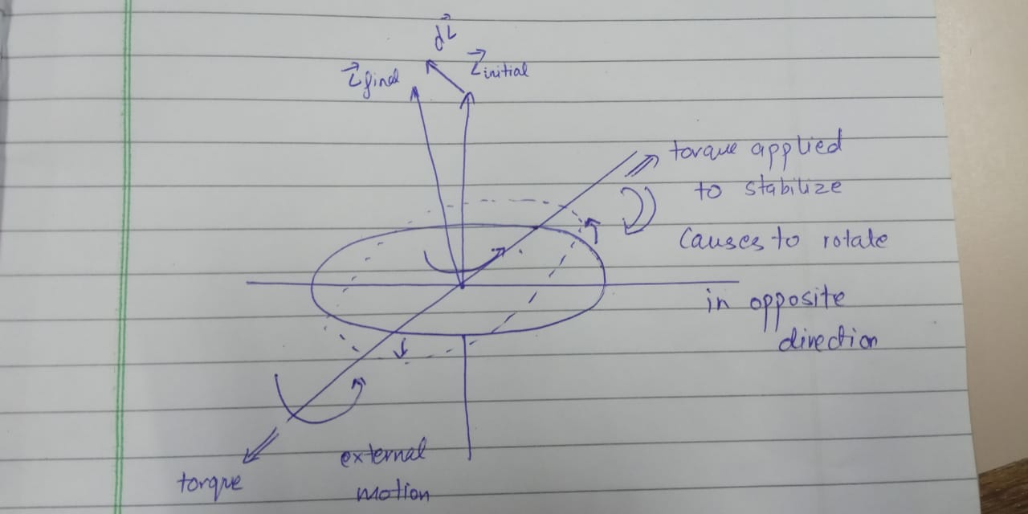
Whenever there is external rotation it exerts a torque on the gyroscope, thus causing it to rotate. The gyroscope as a result, exerts an equivalent torque in the opposite direction which helps in stabilizing the tremor. Notice that if the gyroscope is not allowed to rotate about the horizontal axis, there will be no restabilizing torque.
DISA 2019 | Prof. M. Balakrishnan | Rachit Jain, Chirag Bansal, Ishan Jain

Slide 19
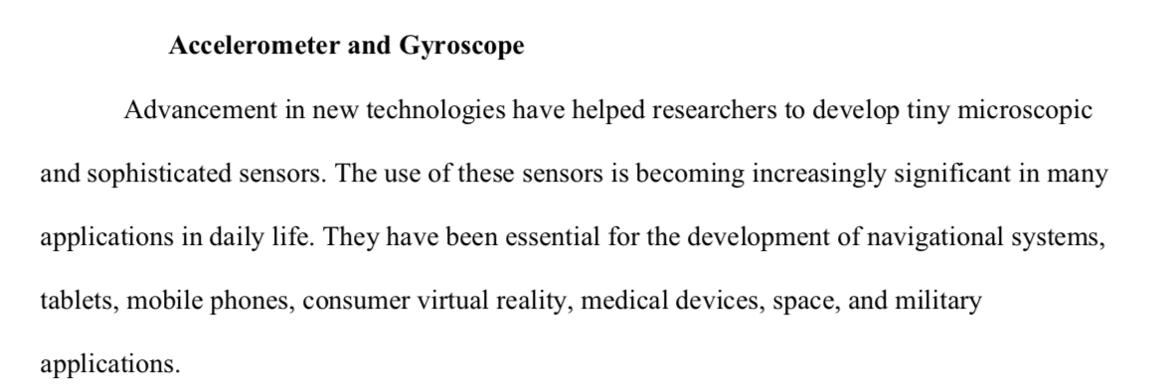
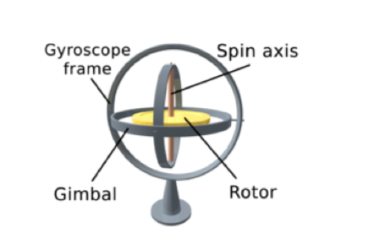
DISA 2019 | Prof. M. Balakrishnan | Rachit Jain, Chirag Bansal, Ishan Jain

Slide 20
Collecting Database
Next came the task of collecting database. False tremors stimulated by our hands were decent enough to test our model for its functioning. But, to match a new tremor pattern with the actual tremor signal obtained from a Parkinson affected patient and to do pattern matching for detecting the involuntary movements was much required.
Actual data would have increased the reliability of the project, along with giving us more sense to what we are looking for in the signals. This required medical approval and a ready device to be tested on patients; both of which required serious prerequisites.
DISA 2019 | Prof. M. Balakrishnan | Rachit Jain, Chirag Bansal, Ishan Jain

Slide 21
Research Centres in India Approached research centres in India working on Parkinson patients dedicatedly
Department of Neurology, AIIMS, New Delhi
Department of Neurology and Epidemiology, NIMHANS, Bangalore
Jamia Hamdard University, New Delhi
Center for Brain Research, Indian Institute of Science, Bangalore
Bangur Institute of Neurosciences, Kolkata
Parkinson’s Disease and Movement Disorder Society, Mumbai
DISA 2019 | Prof. M. Balakrishnan | Rachit Jain, Chirag Bansal, Ishan Jain

Slide 22
Research Centres Abroad
Duke Health Movement Disorders Center
Toronto Western Hospital Movement Disorders Center
University of Pennsylvania Movement Disorder Center
Pacific Parkinson’s Research Centre, University of British Columbia
Johns Hopkins Parkinson’s Disease & Movement Disorders Center
Singapore National Neuroscience Institute
University of South Florida Parkinson’s Disease and Movement Disorders Center
European Parkinson’s Disease Association
DISA 2019 | Prof. M. Balakrishnan | Rachit Jain, Chirag Bansal, Ishan Jain

Slide 23
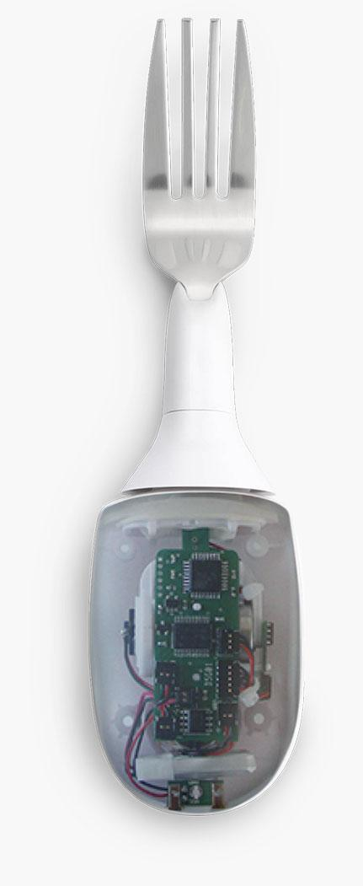
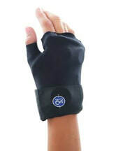
Existing Solutions
To understand what the project demands, it is extremely essential to look out for existing prototypes or solutions worldwide, and getting to know their advantages while not forgetting to notice their loopholes;
somethings which you wish to fulfil.
Reading through research papers
is vital for knowing how to get the
project going as it is the very
source of information which can be
trusted.
DISA 2019 | Prof. M. Balakrishnan | Rachit Jain, Chirag Bansal, Ishan Jain

Slide 24
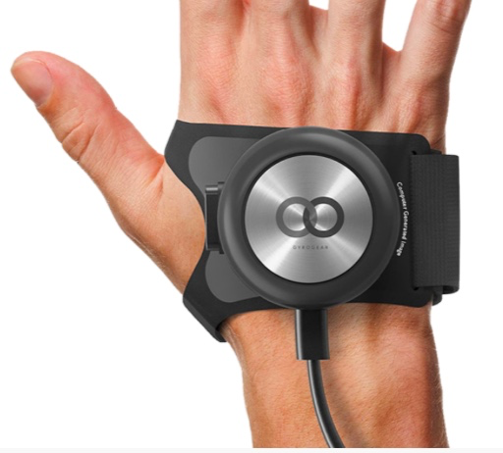
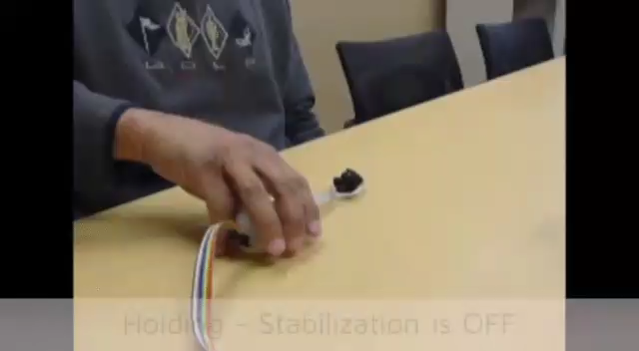
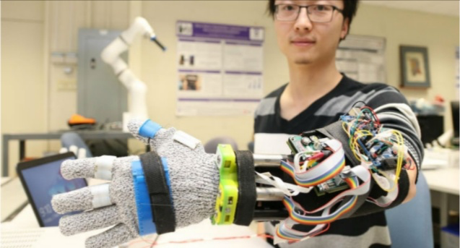
Innovation Component
There are solutions catering to specific needs like ease of eating, but not a general, cheap implementation
No indigenous solution to the problem as of now
We intend to make a wearable glove that minimises the effect of tremors significantly
Existing Solutions
GyroGear
Development Stage
Parkinson’s Spoon
Commonly Used
Similar prototype developed by University of Western Ontario
Extremely Costly
Doesn’t reduce the tremors in fingers
Specific solution catering only to problem of eating
Extremely bulky prototype
₹ 50,000/-
₹ 13,000/-
NA
DISA 2019 | Prof. M. Balakrishnan | Rachit Jain, Chirag Bansal, Ishan Jain

Slide 25
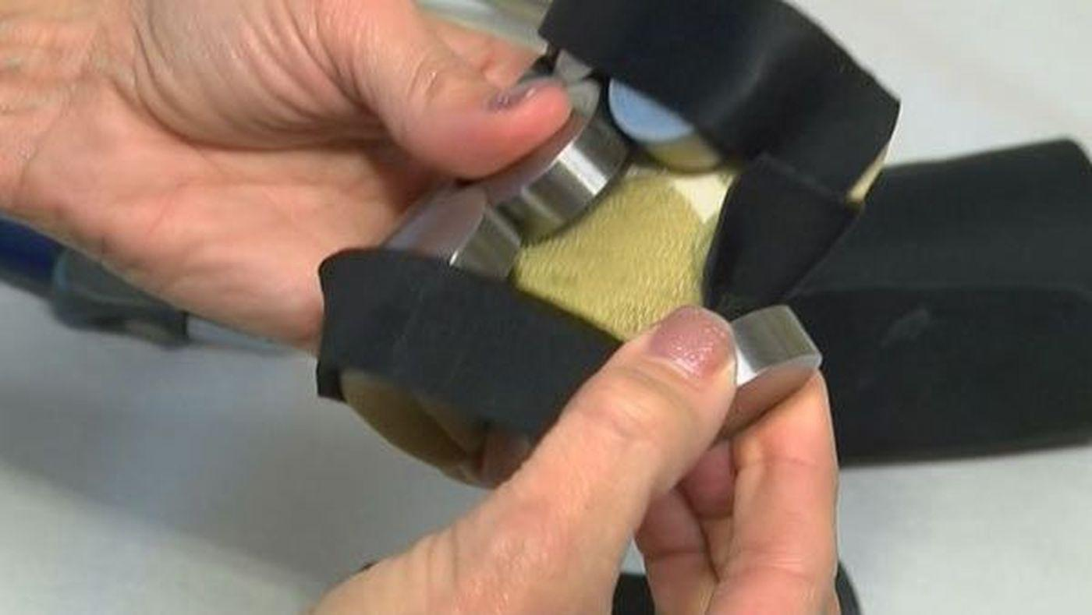
Readi-Steadi®
Reference - https://www.readi-steadi.com/
https://www.youtube.com/watch?v=HW9JPadlN2I
https://www.essentialtremor.org/treatments/assistive-devices/
Anti Tremor Orthotic Glove System
The glove uses multiple weights distributed across the hand to reduce the effect of tremors in the hand.
Conditions catered are:
Parkinson’s Disease
Essential Tremors
Dystonic Tremor
Resting Tremor
Action Tremor
Cerebellar Tremor
Psychological Disorders
Has to be adjusted as per each individual’s tremor pattern
0.45 kg; claims to be comfortable and easy to wear for extended times with no muscle fatigue
Costs $300 per glove
DISA 2019 | Prof. M. Balakrishnan | Rachit Jain, Chirag Bansal, Ishan Jain

Slide 26
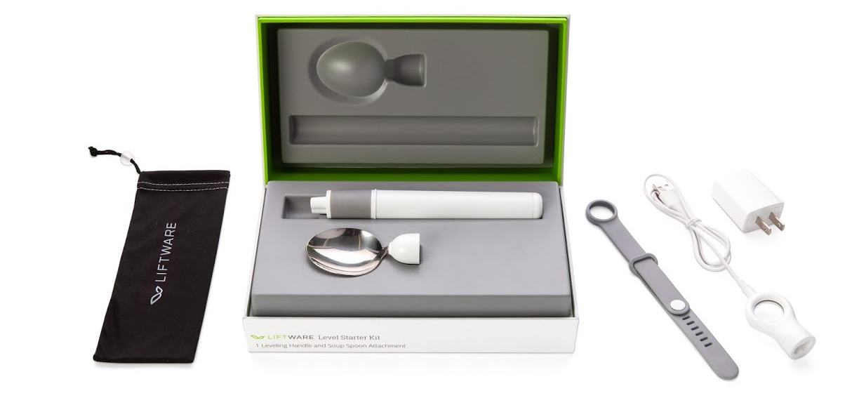
PROS:
Working product; available in the market
Easy to use
CONS:
Costs $200
Each add-on (spoon, fork) head to be bought separately
Specific for the task of “eating”
DISA 2019 | Prof. M. Balakrishnan | Rachit Jain, Chirag Bansal, Ishan Jain

Slide 27
Liftware Steady™
US20140052275A1
Reference - https://patents.google.com/patent/US20140052275A1/en Referen ce https://www.liftware.com/steady/
It is an electronic stabilizing handle with various head attachments
It is designed to help people with hand tremor, which may be related to Parkinson's disease or essential tremor, eat more easily
The stabilizing handle contains sensors that detect hand motion and a small onboard computer that distinguishes unwanted tremor from the intended movement of the hand.
To stabilize the utensil, the computer directs two motors in the handle to move the utensil attachment in the opposite direction of any detected tremor.
DISA 2019 | Prof. M. Balakrishnan | Rachit Jain, Chirag Bansal, Ishan Jain

Slide 28
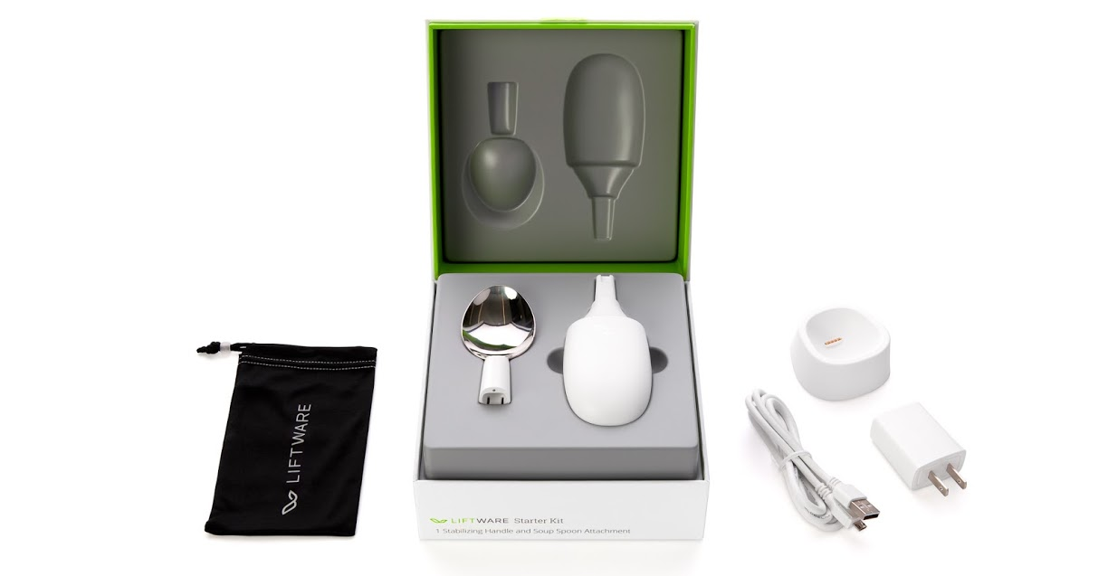
PROS
Working
Available commercially
Easy to use
CONS
Costs $200
Each add-on (spoon, fork) has to be bought separately
DISA 2019 | Prof. M. Balakrishnan | Rachit Jain, Chirag Bansal, Ishan Jain

Slide 29
iStopShaking®
US20180289309A1
Reference - https://patents.google.com/patent/US20180289309A1/en
https://www.youtube.com/watch?v=kgRgcmiS-vI
‘Ablate’ refers to inhibiting, attenuating, lessening or countering shaking by mechanical means.
Powered by 25-30 mini gyroscopes (spinning at 40,000 rpm)
Driven by a brushless DC (BLDC) driver controller and a long life battery.
Triaxial Accelerometers are used to sense both static (e.g. gravity) and dynamic (e.g. sudden starts/stops) acceleration along three cartesian axis.
The accelerometer is used for tilt-sensing and to sense gyroscope motion.
PROS:
Works over the whole hand; at all joints (fingers)
Better results courtesy many gyroscopes
CONS:
It is a “prototype”
Covers the whole of hand and hence, might be uncomfortable
DISA 2019 | Prof. M. Balakrishnan | Rachit Jain, Chirag Bansal, Ishan Jain

Slide 30
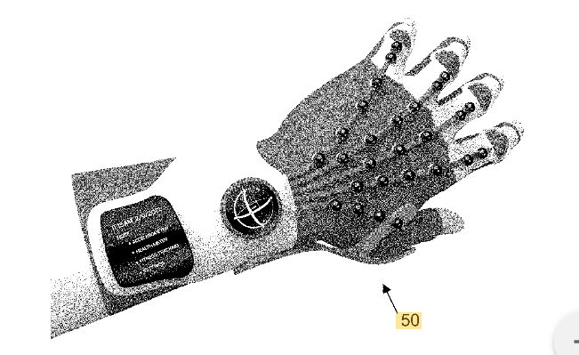
DISA 2019 | Prof. M. Balakrishnan | Rachit Jain, Chirag Bansal, Ishan Jain

Slide 31
Project Emma Reference: https://www.microsoft.com/en-us/research/project/project-emma/
Introduces a rhythmic vibration effect through small motors around the wrist
The ability to move is regulated by a sensorimotor feedback loop, involving the perception of movement and position of the body.
The tremor symptom could arise from an erroneous feedback loop, where the brain is overcompensating for an initial movement error, resulting in a continuous tremor.
The injection of vibration by the Emma Watch introduces white noise* that short-circuits this erroneous feedback loop, stopping the brain from sensing the initial error and its try to overcompensate.
This kind of haptic technology can be used to prevent movement disorders.
PROS:
Comfortable, confined area
Blends to the eye
No gyroscopes involved
CONS:
Project in research stage under Microsoft Research team
Specific to Emma’s symptoms; might not be medically approved
Generating vibrations to nullify vibrations
*White Noise: In signal processing, white noise is a random signal having equal intensity at different frequencies, giving it a constant power spectral density.
DISA 2019 | Prof. M. Balakrishnan | Rachit Jain, Chirag Bansal, Ishan Jain

Slide 32
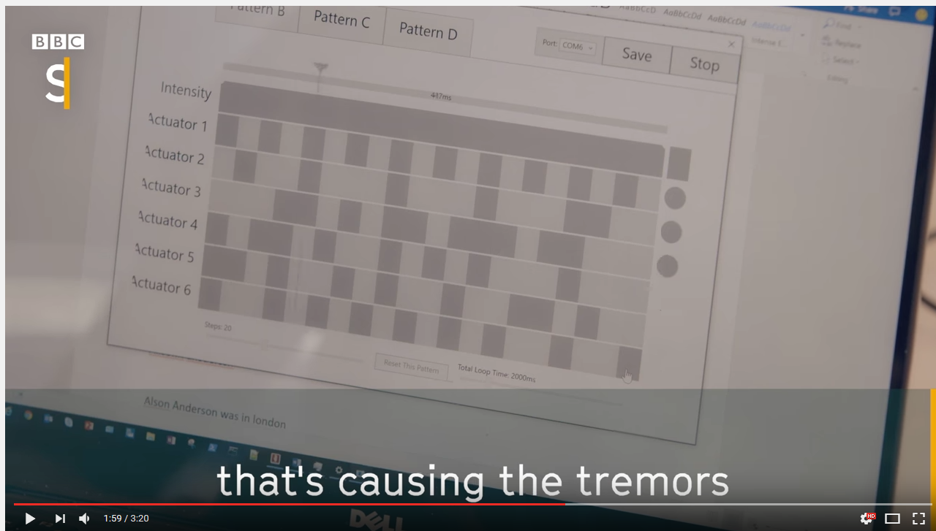

Improved Handwriting; almost no tremor in hands
Used 6 different frequencies to generate “white noise”
DISA 2019 | Prof. M. Balakrishnan | Rachit Jain, Chirag Bansal, Ishan Jain

Slide 33
Extra points:
LiftWare: It is an eating device that reduces tremor by 70%. It is very expensive 195$ for one spoon and only helps in eating.
Alimed: This is a company that creates non-spill tumblers and drinking aids for prevention of spilling and helping in drinking. They don’t reduce tremor they just reduce spilling.
DISA 2019 | Prof. M. Balakrishnan | Rachit Jain, Chirag Bansal, Ishan Jain

Slide 34
Plan Overview
A survey of patients
Consulting individuals and organisations working in the field
Development of a centralised database to keep all information collected so far
Understanding the electrical devices to be used profoundly
Choosing the most suitable devices to be used
Analysing the circuitry to be used and creating the relevant algorithms
Improving the model developed so far by repeated feedbacks
Creating a prototype or theoretical model of the glove
DISA 2019 | Prof. M. Balakrishnan | Rachit Jain, Chirag Bansal, Ishan Jain

Slide 35
TEST FOR PARKINSON’S DISEASE
Reference: https://www.youtube.com/watch?v=cxHpFWKIfGw
The four cardinal parts of the exam for Parkinson's Disease are:
Bradykinesia (Fist Open-Close, Finger Tapping, Toe Tapping, Heels Tapping)
Rigidity
Tremor (usually rest tremor but also kinetic and intentional tremor)
Issues with gait and postural instability
OBSERVATIONS
Spontaneous Movements
Eyeblinks
Fidgeting
Crossing/Uncrossing Legs
Tremor
Shuffling Gait
NORMAL SIGNS
Turns with no loss of balance
Step length normal, not small
Heel strike present
Arm Swing Present
Does not take more than 2 steps to regain balance if tugged
DISA 2019 | Prof. M. Balakrishnan | Rachit Jain, Chirag Bansal, Ishan Jain

Slide 36

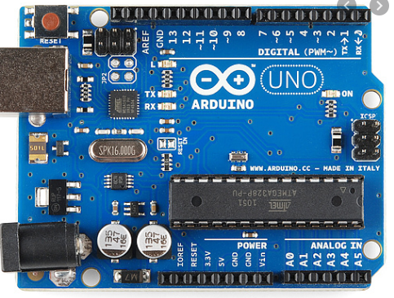
Microprocessor
After identifying the existing solutions and understanding the problem statement clearly, we figured that we would require a microprocessor to collect the data and process it. Raspberry Pi could be used but it was not ergonomic. Thus, we discarded the idea and went ahead with using Arduino for our purpose.
Arduino is quite user-friendly and easy to understand. It can be programed to our use and have extensive application in electrical circuits and signal processing.
DISA 2019 | Prof. M. Balakrishnan | Rachit Jain, Chirag Bansal, Ishan Jain

Slide 37
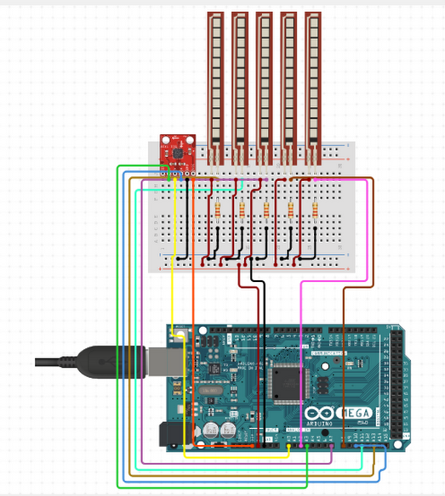
Ciruito.io - Virtual Circuit
Using “ciruito.io”, created a basic layout of our circuit, including the use of flex sensors, if needed, in each finger of the hand.
The use of flex sensors could sideline extra gyroscopes needed at each joint in the finger to sense the amount of curl in each finger. Flex sensors are like variable resistors that can be used to analyse the extent of fold in them.
DISA 2019 | Prof. M. Balakrishnan | Rachit Jain, Chirag Bansal, Ishan Jain

Slide 38
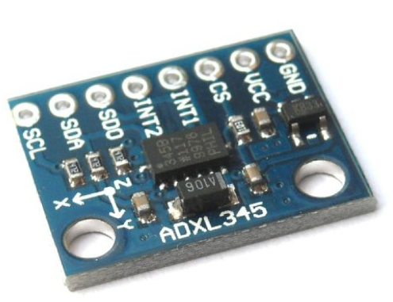
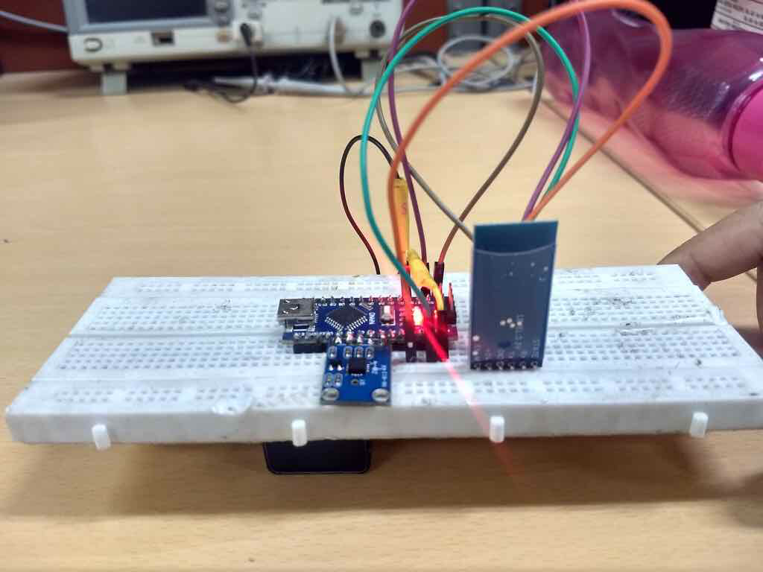
Using Accelerometer (ADXL 345)
The module sends acceleration data in all three axes with respect to a certain datum (when placed on a flat table top)
The acceleration could be interpreted as tilt angle wrt origin coordinate planes and thus the rotation in degrees
Using Bluetooth Module (HC-05)
The module sends data signals wirelessly from the bluetooth circuit it is connected to the laptop
The rate of signal sending is quite high and efficient (atleast less than 10 milliseconds for which we tested it)
DISA 2019 | Prof. M. Balakrishnan | Rachit Jain, Chirag Bansal, Ishan Jain

Slide 39
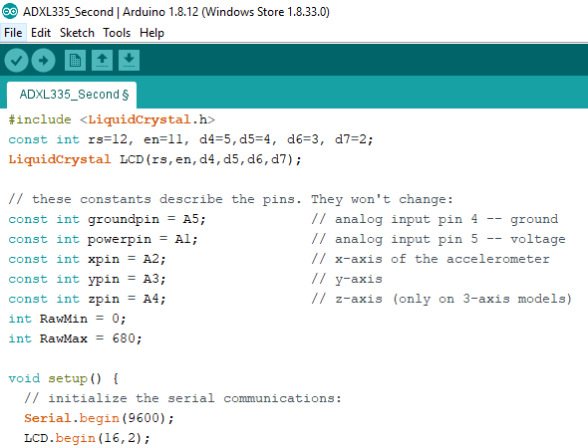
Using Arduino
Created an Arduino Code for retrieving data from ADXL345 and display it on an LCD screen and graph it using the Serial Plotter”, an inbuilt function of Arduino platform, on the computer screen to analyse the usefulness of the data achieved.
Enhanced the code further to make it clean and efficient
DISA 2019 | Prof. M. Balakrishnan | Rachit Jain, Chirag Bansal, Ishan Jain

Slide 40
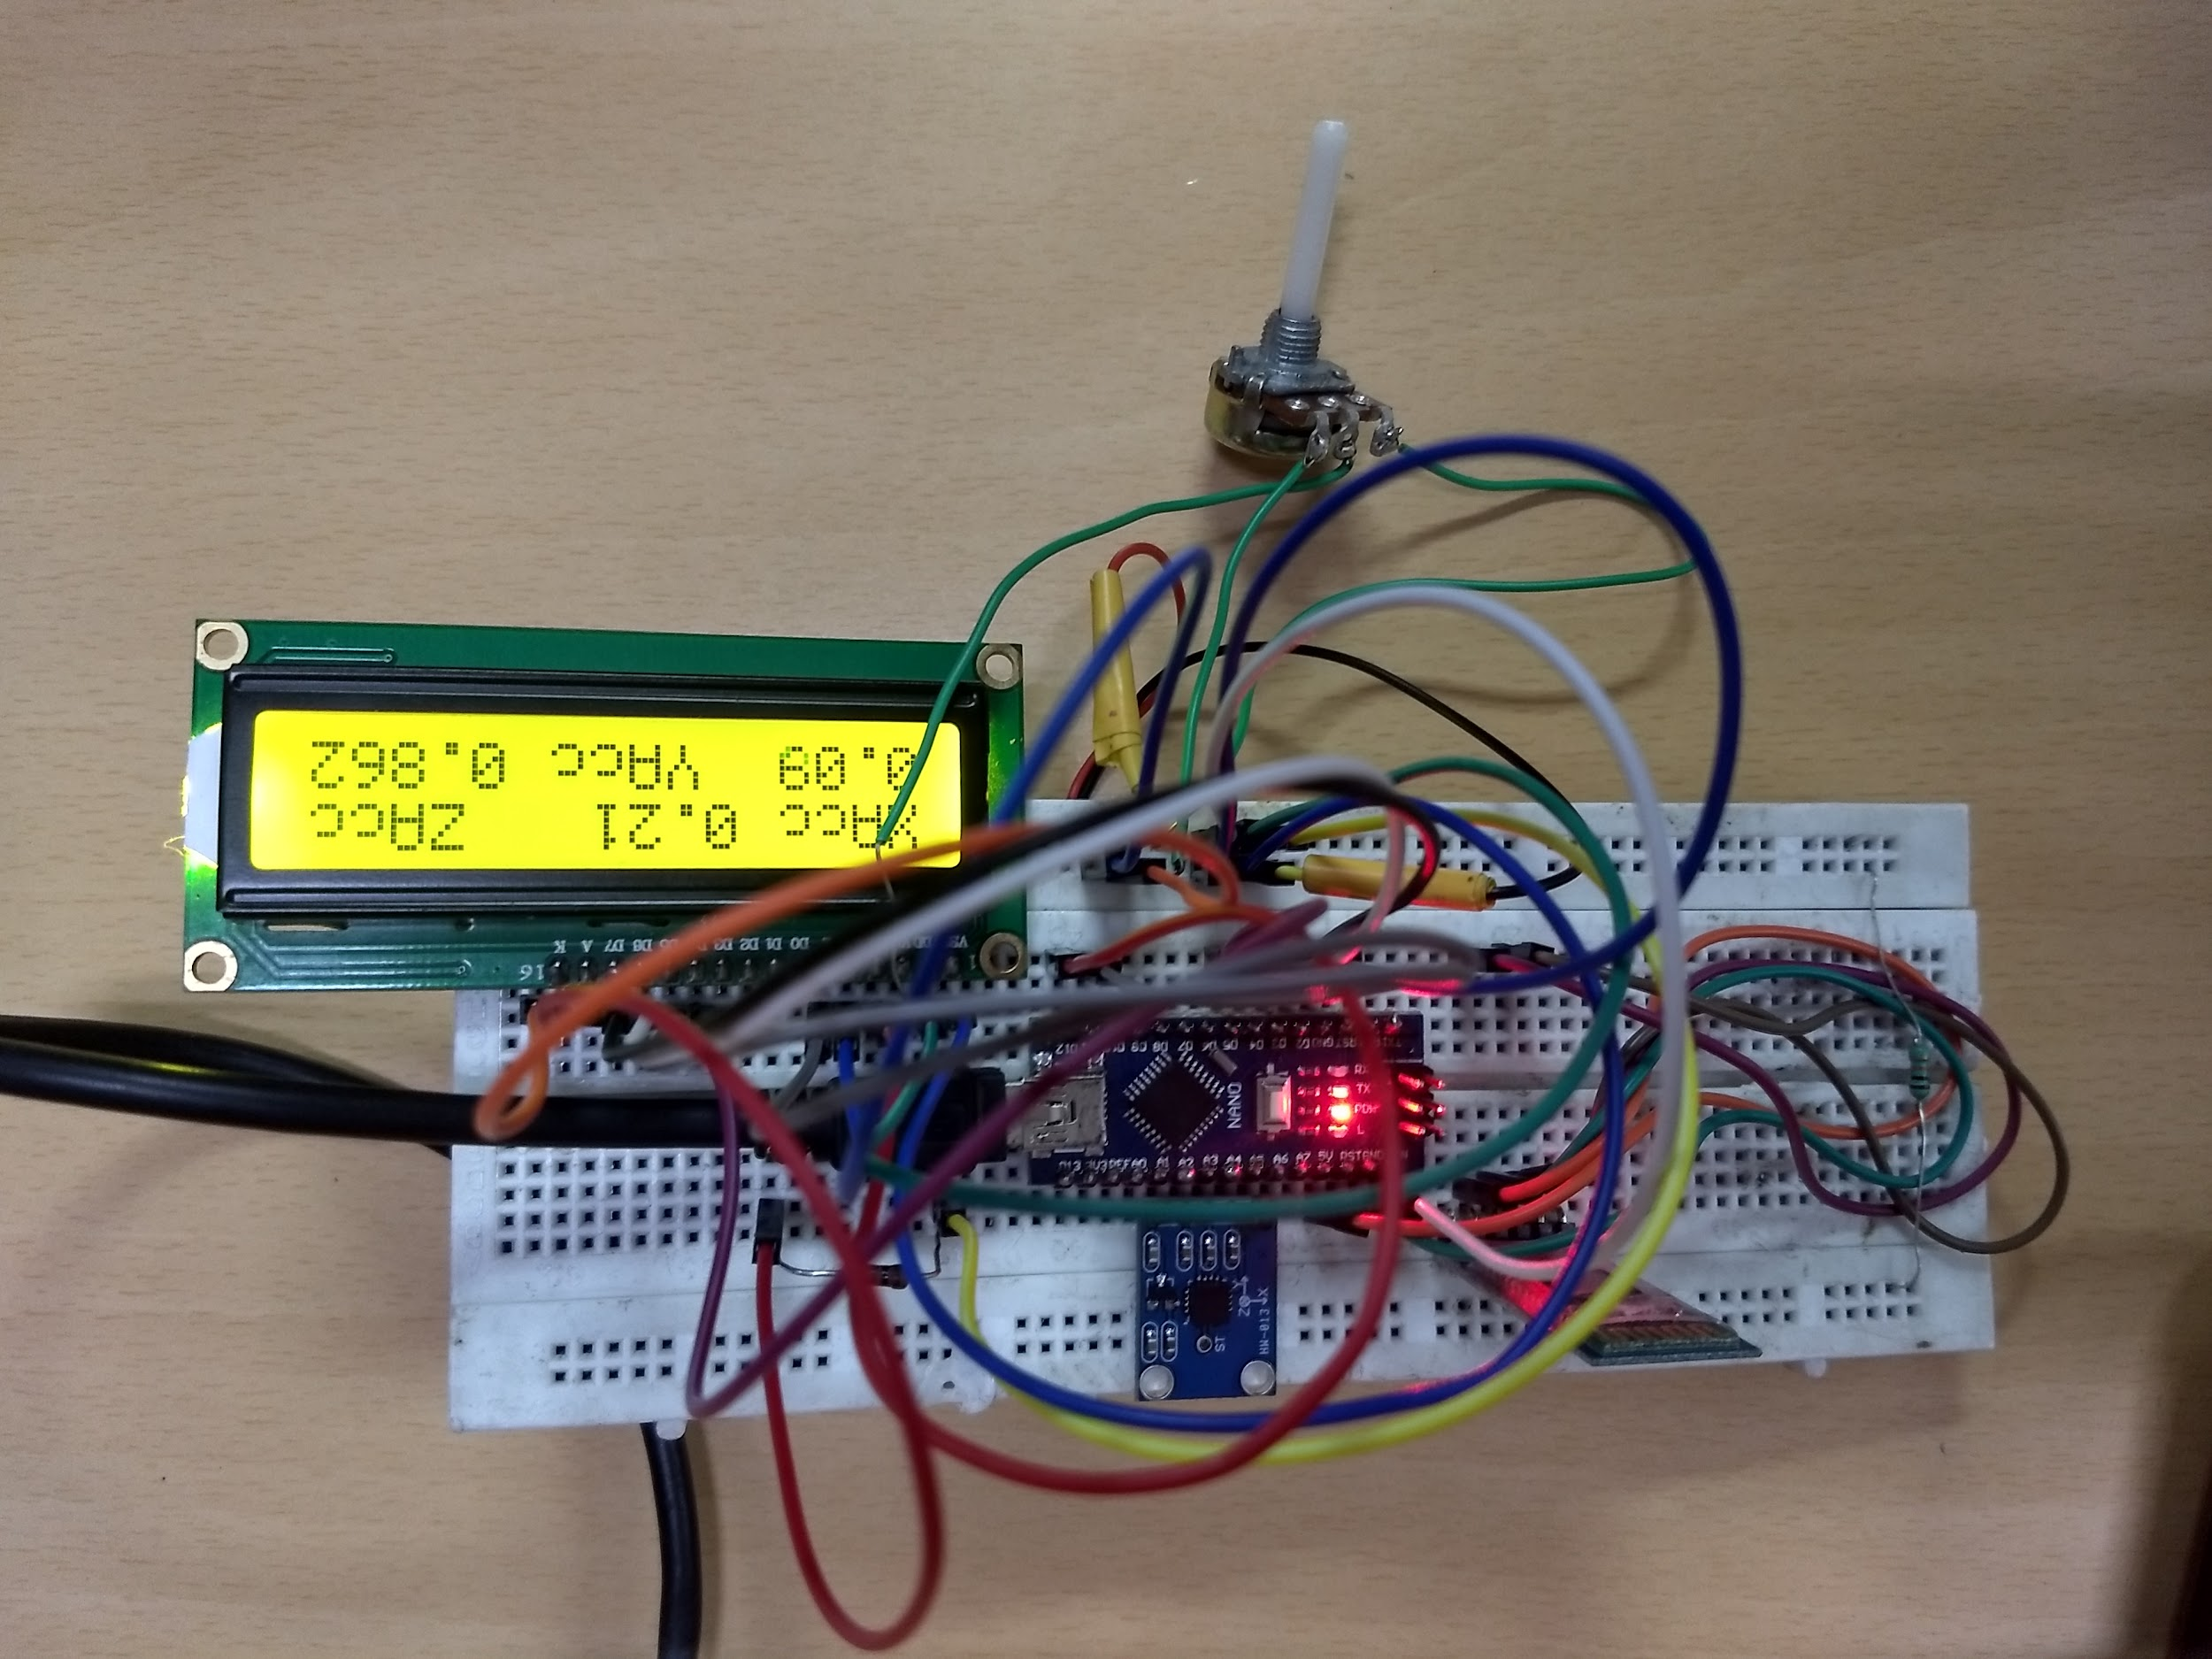
Using LCD Screen
To instantaneously look at our data while creating test data from false tremors of our hands, we used an LCD screen in the circuit; showing the tilt angle/accelerations in all three axes with respect to the mean position of the gyroscope used.
Used LCD screen to display the essentials acceleration in all three directions of motion
It was extremely useful to get real time insights to data without actually viewing the laptop for data
DISA 2019 | Prof. M. Balakrishnan | Rachit Jain, Chirag Bansal, Ishan Jain

Slide 41
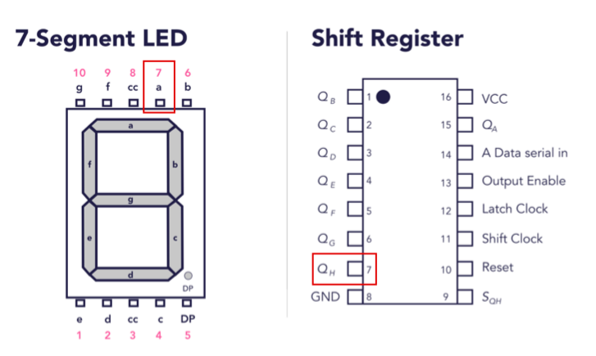
Layout of 7-segment LED to understand how one can display the readings from Arduino directly onto a LCD/LED screen
DISA 2019 | Prof. M. Balakrishnan | Rachit Jain, Chirag Bansal, Ishan Jain

Slide 42
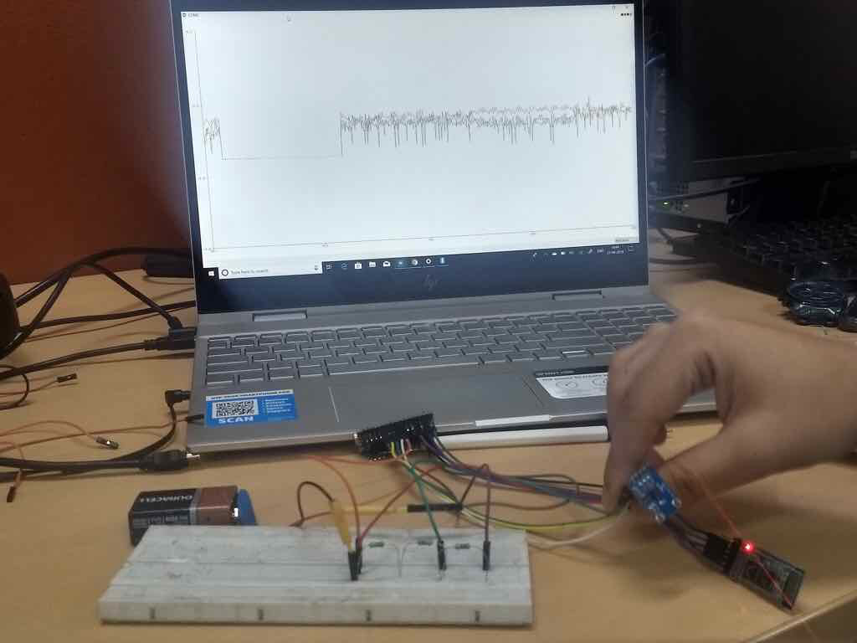
A glimpse of what we achieved from the wireless, battery driven, bluetooth coupled circuit using Arduino UNO and a single accelerator (ADXL345).
The signal was dynamic and the bluetooth sensitivity was analysed and its range found to be:
10m without walls in between
about 5m with significant obstructions
DISA 2019 | Prof. M. Balakrishnan | Rachit Jain, Chirag Bansal, Ishan Jain

Slide 43
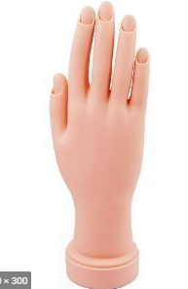
Hand Tremor Mimicking Device
Simulating tremors on hands and generating signals through that wasn’t an appreciable approach once we had more clarity on the problem. Upon discussion with our faculty mentor and on the back of multiple research pahand tremor mimicking depers, we decided to go about developing a vice first, which would delay our first-hand interaction with the patients.
The device could be used to generate signals when mounted by our circuit. This would reduce the redundant signals that are present in the normal movement of the hand.
DISA 2019 | Prof. M. Balakrishnan | Rachit Jain, Chirag Bansal, Ishan Jain

Slide 44
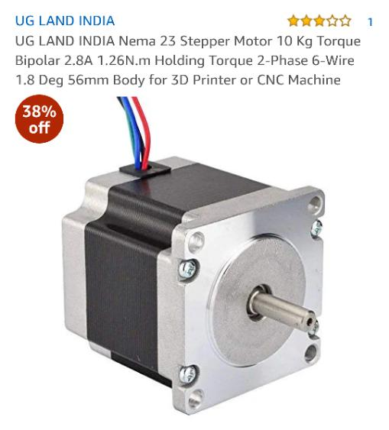
Stepper Motors
An appropriate stepper motor was to give the required torque to successfully mimic the tremors on a hand model as that would remove any voluntary movement present in the case we were simulating tremors on our hands.
A brushless DC Motor divides full rotation into number of equal steps, thus efficiently rotating the required model for tremor simulation
NEMA 23 Stepper Motor had the required specifications and gave the necessary torque to handle the model. The slip between the shaft of motor and the collar of the model was removed by using a 3D printed acrylic solid.
DISA 2019 | Prof. M. Balakrishnan | Rachit Jain, Chirag Bansal, Ishan Jain

Slide 45
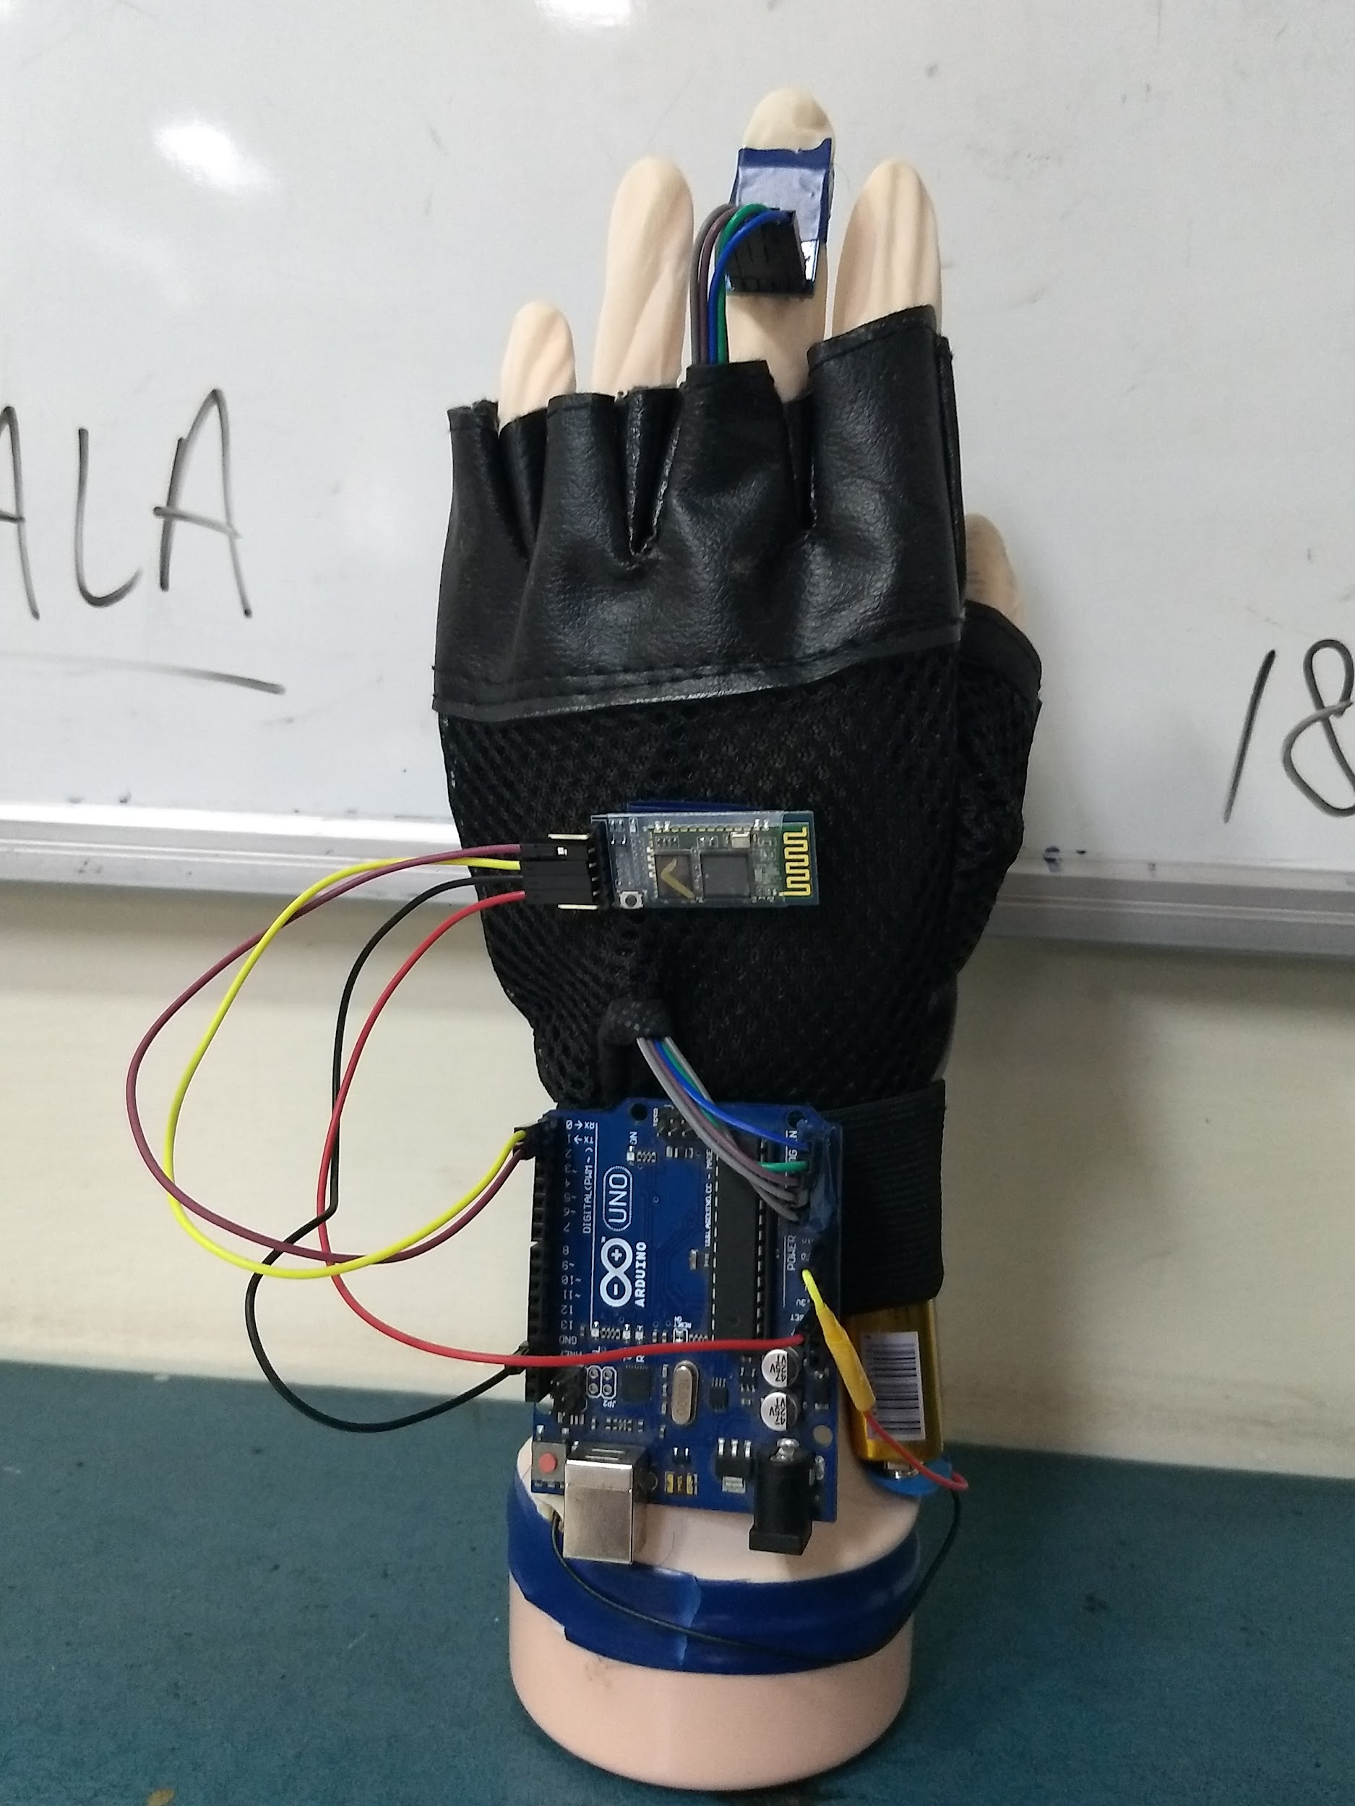
FINAL DESIGN
A rubberised hand model was chosen to be mounted with the electric circuit made, consisting of ADXL345 (Accelerometer), HC-05 (Bluetooth Module), Arduino UNO with a simple design put on a double-layered glove to carry all components in the inside.
The glove could be removed from the model and put on human hand as it is, as tested on our faculty mentor. The material has not been chosen with care for now as it would be taken into consideration during fabrication process.
DISA 2019 | Prof. M. Balakrishnan | Rachit Jain, Chirag Bansal, Ishan Jain

Slide 46
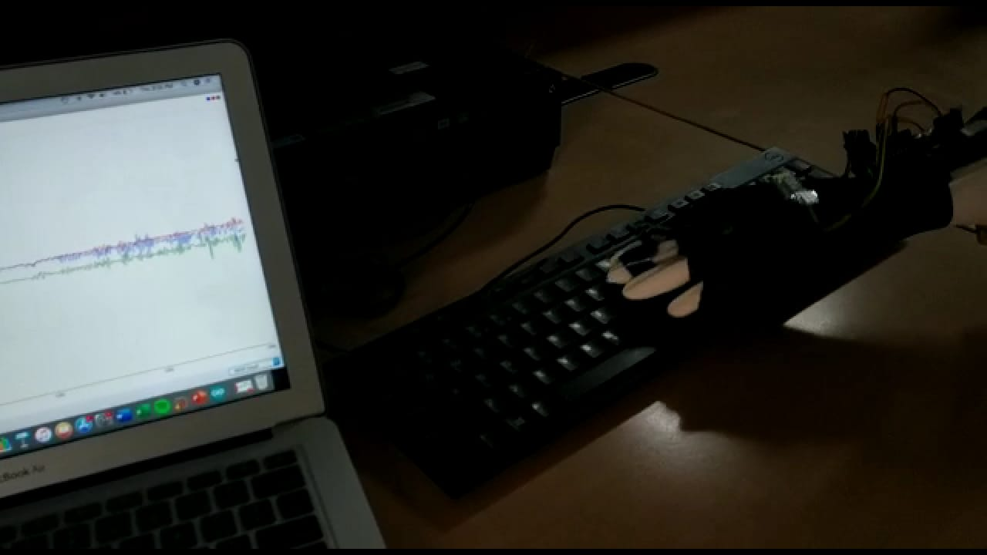
Testing the final design...
The glove, with all equipments mounted, was finally tested on numerous categories:
Accuracy
Sensitivity
Comfort
Compactness
Usability
Thought
We found the glove to give decent results in all above categories, with the material to be chosen correctly while on the stage of fabrication.
DISA 2019 | Prof. M. Balakrishnan | Rachit Jain, Chirag Bansal, Ishan Jain

Slide 47
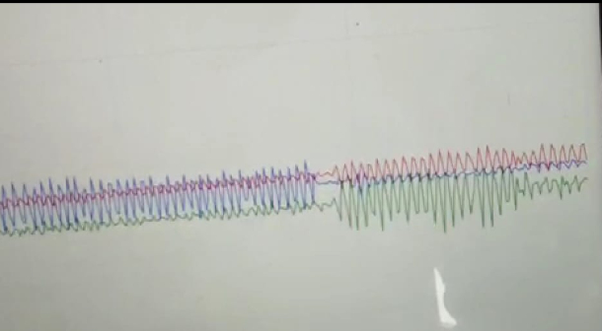
Final Plot - Motion in various planes
Motion in 3rd plane
Motion in 2nd plane
Motion in 1st plane
This graph was plotted as acceleration v/s time for oscillatory, periodic motion generated by to and fro motion of the hand in various planes.
DISA 2019 | Prof. M. Balakrishnan | Rachit Jain, Chirag Bansal, Ishan Jain

Slide 48
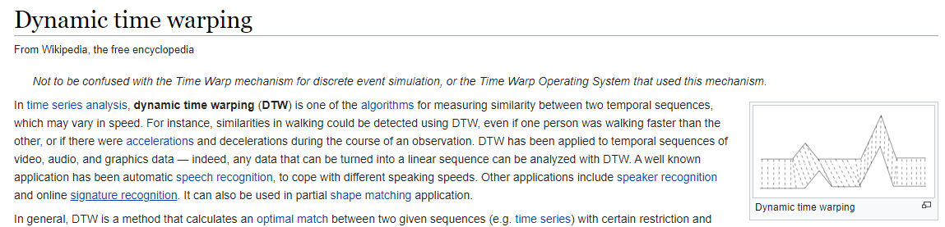
Dynamic Time Warping
Signal Processing could be used to detect and match repeating signals from the incoming signal from a set of recorded samples. This is something like learning the previous datasets to analyse the incoming new signal.
For this, a huge database of actual tremor signals is needed, which calls in for a medical approval to have our testing device implanted on patients. We then decided to improvise our prototype much better before actually having them on patients.
DISA 2019 | Prof. M. Balakrishnan | Rachit Jain, Chirag Bansal, Ishan Jain

Slide 49
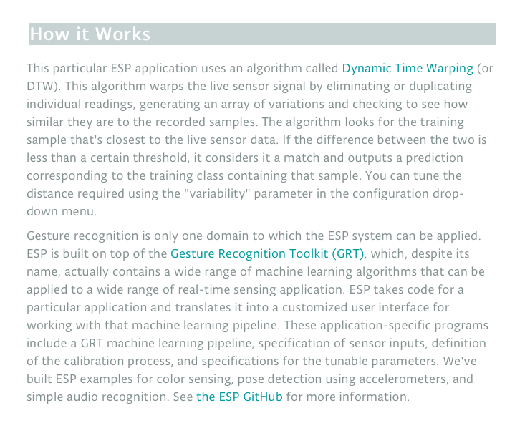
Gesture Recognition Toolkit
It was used initially to mimic dynamic time warping in out hand-produced tremor signals. This required some more knowledge of Machine Learning and a better hold on it’s basics which we got through Coursera and LinkedIn courses for the same.
DISA 2019 | Prof. M. Balakrishnan | Rachit Jain, Chirag Bansal, Ishan Jain

Slide 50
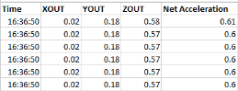
Data Collection and Storage
After we were able to see the data from the Arduino we needed to store the data so that we can easily process that, after getting the data we read about what would be the best way to store the data and we understood that it would be best if we were able to store the data in a CSV file as they are many frameworks that can read these files, store them and clean them. Subsequently, we found that there is a software called “Processing.h” which has code based on C++ that can understand and store data from Arduino/Rasberry pi and then store in .CSV format. So we wrote a C++ programme that will read the data from the Arduino and then store it a .CSV file.
DISA 2019 | Prof. M. Balakrishnan | Rachit Jain, Chirag Bansal, Ishan Jain

Slide 51
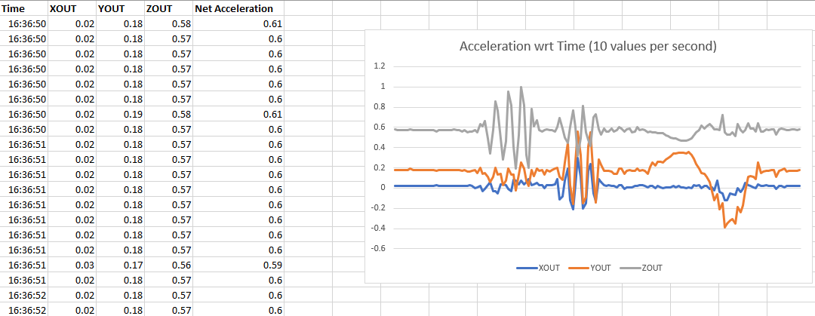
A graph based on set of values attained at an interval of 0.1 seconds using HC-05 Bluetooth Module attached to the circuit. The sensitivity of the gyroscope was sensed with careful experiments for multiple days.
DISA 2019 | Prof. M. Balakrishnan | Rachit Jain, Chirag Bansal, Ishan Jain

Slide 52
Food for Thought - Future Objectives
Just like any other project, there were a few points which must be highlighted so that the project can be taken up from this point ahead. Following objectives were a part of the brainstorming we had during the project duration, some of them we implemented to a little extent but could not be laid down in the report.
Application of ML and designing a logistic regression model (using binary trees, K-nearest neighbours for a set of data points marked a ‘tremor’, to generate a prediction model, comparing the input (new) signal with the datasets taken preferably from patients having degenerative neurological diseases.
Improvising the tremor mimicking device and simulate numerous sinusoidal signals passed through Arduino.
Implementing correctly a feedback system which could filter out the involuntary signals from the incoming tremor pattern.
Use of gyroscopes to resist the involuntary ‘tremors’ while the glove is on hand
Use of a ventilated, porous material to extend the comport to user while the glove is on.
DISA 2019 | Prof. M. Balakrishnan | Rachit Jain, Chirag Bansal, Ishan Jain

Slide 53
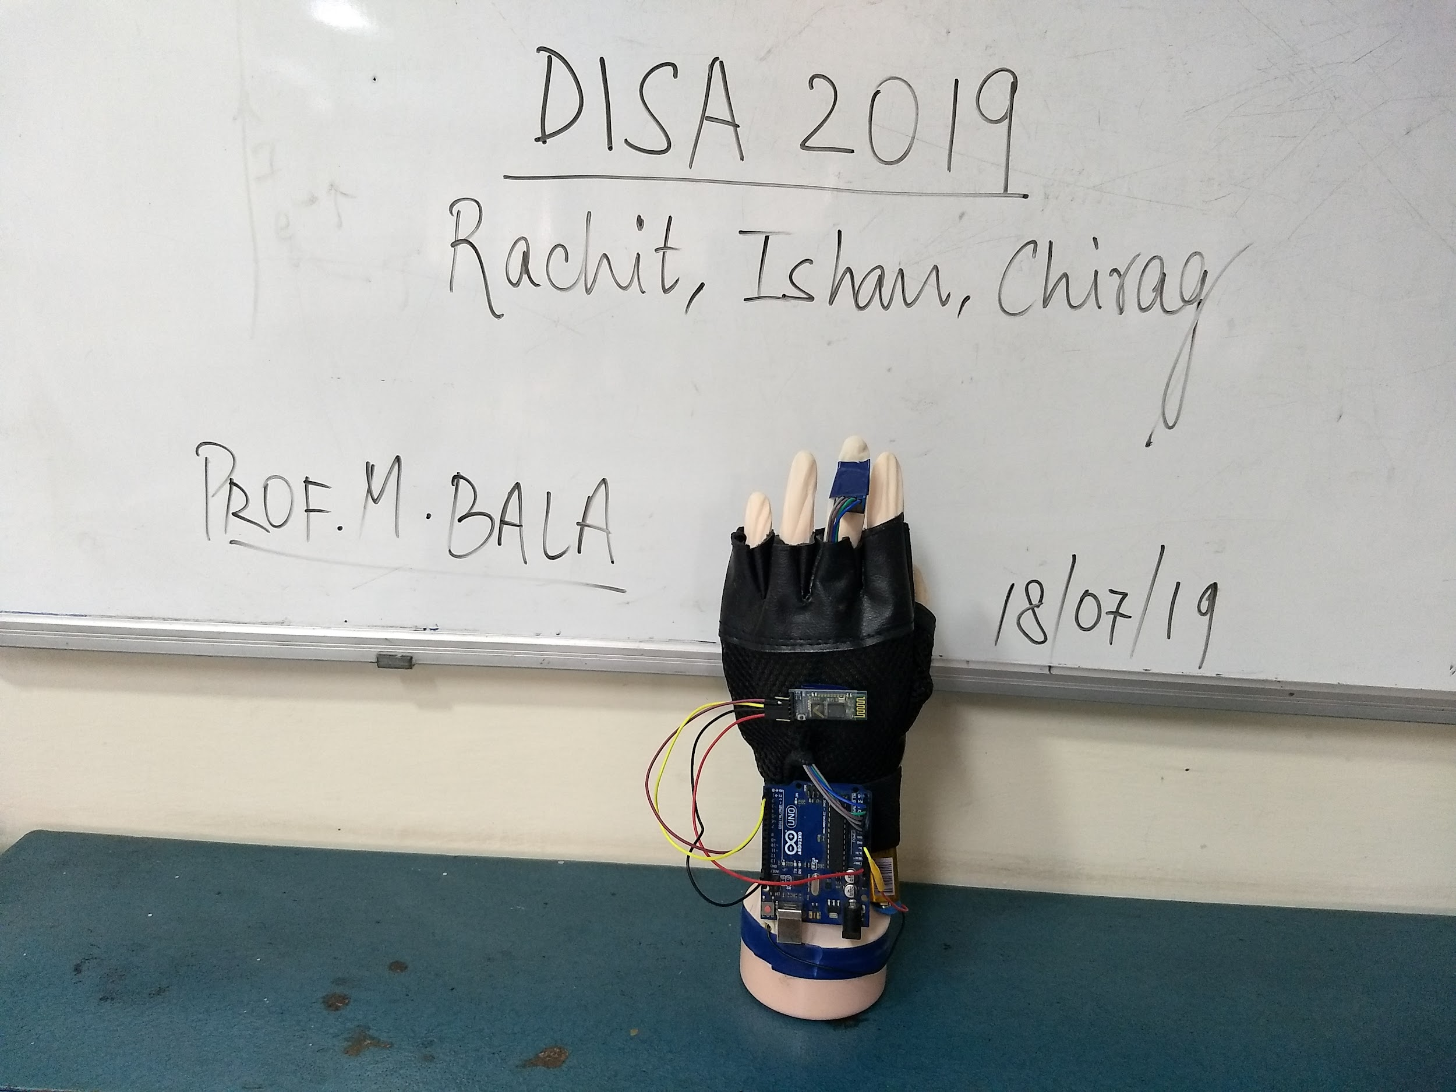
DISA 2019 | Prof. M. Balakrishnan | Rachit Jain, Chirag Bansal, Ishan Jain

